Slide 1
CLIPS – Programming Language (C Language Integrated Production System)
Kevin Chan
Haiqi Hao

Slide 2
Introduction of CLIPS
CLIPS (C Language Integrated Production System) is a tool to build expert system, it is also a multiparadigm programming language that provides support for rule-based, object-oriented, and procedural programming. It was developed by NASA in the 1980s to model human knowledge and automate reasoning.

Slide 3
History of CLIPS
Influenced by OPS5 and ART
Implemented in C for efficiency and portabiliy
Developed by NASA, distributed and supported by COSMIC
Runs on PC, Mac,UNIX

Slide 4
CLIPS in Expert System
One of the most popular tools for implementing an expert system is CLIPS. It provides a complete environment for the construction of rule and/or object based expert systems. Its inference engine internally uses the Rete Algorithm for pattern-matching : Find fitting rules and facts.

Slide 5
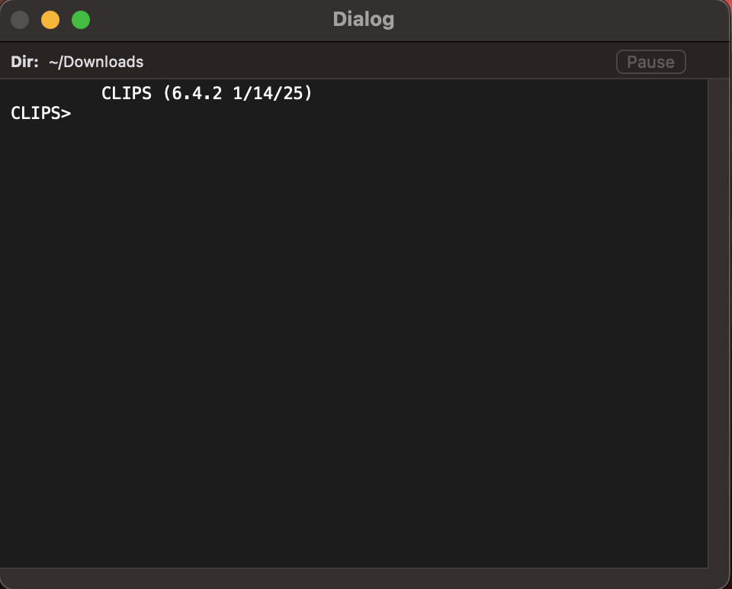
Installation of CLIPS
You can download it from the official website: https://www.clipsrules.net/
Download the application base on your computer OS
Execute the application
CLIPS on MacOS

Slide 6
Components of CLIPS
Rule-Based Language
Can create a fact list
Can create a rule set
An inference engine matches facts against rules
Object-Oriented Language
Can define classes
Can create different sets of instances
Special forms allow you to interface rules and objects

Slide 7
CLIPS Commands
(exit)
(run)
(clear)
To exit from CLIPS
(reset)
To clear the environment from facts, rules, and other active definitions
To set the fact base to its initial state (clears existing facts; sets (initial-fact), and all (deffacts) constructs in the program
Executes a program currently loaded into the CLIPS interpreter against currently defined rule-bases and fact bases

Slide 8
CLIPS Commands
(load "HIU.clp")
To load a CLIPS program into the interpreter from the file named “HIU.clp”.
(facts)
To display a list of currently active facts in the fact base.
(rules)
To display a set of rules currently in the rule base.
(agenda)
To display all potential matches of active facts for all rules.
Notes:
(load "HIU.clp") – This also does syntac check and makes constructs in the file defined.

Slide 9
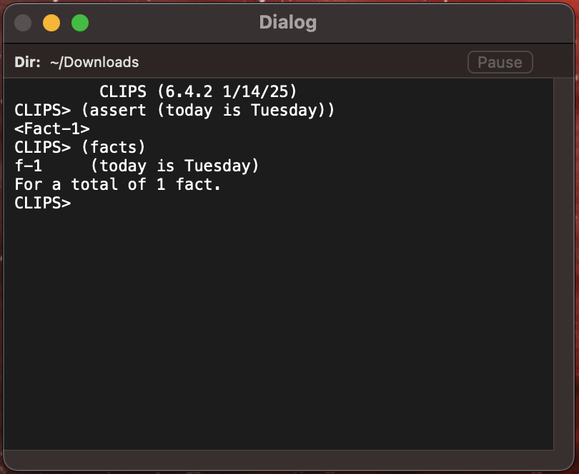
Defining Facts

Slide 10
Defining Rules
Rules have the following structure
(defrule rule-name optional-comment
optional-declaration
condition
…
condition
=>
action
…
action
)

Slide 11
Typical CLIPS Application
Expert Systems (medical diagnosis)
Decision support systems
Knowledge-based AI systems
Configuration systems

Slide 12
Advantages vs Limitations
Advantages
Easy to model human reasoning
Explainable logic (transparent rules)
Efficient pattern matching
Limitations
Not suited for numerical-heavy computation
Can become complex with many rules
Limited modern ecosystem compared to Python-based AI

Slide 13
CLIPS vs Modern AI
Aspect | CLIPS | Modern AI (e.g., ML)
Approach | Rule-based | Data-driven
Transparency | High | Usually low
Learning | Manual rules | Automatic training
Use Case | Logic systems | Prediction and Pattern recongnition

Slide 14
When You Should Use CLIPS
Use CLIPS if:
You need explicit reasoning
Rules are clearly defined
Explainability is critical
Avoid it if:
You need machine learning
Data is large and unstructured

Slide 15
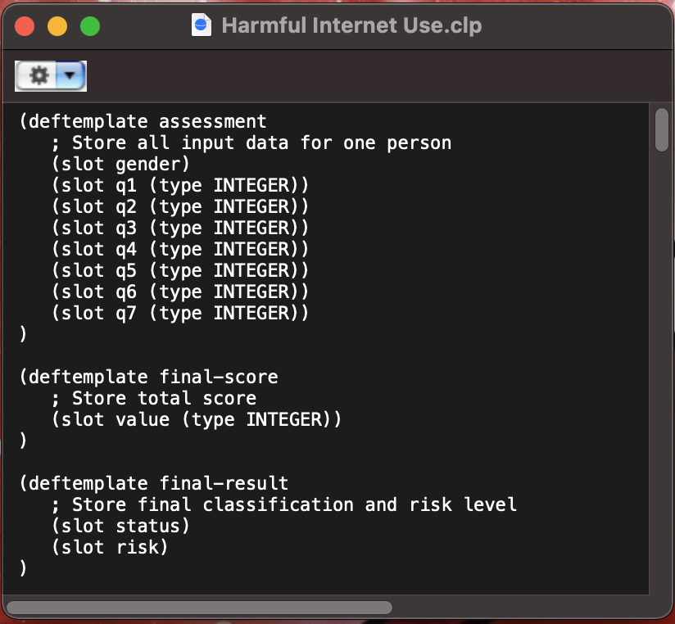
Defining Template Example

Slide 16
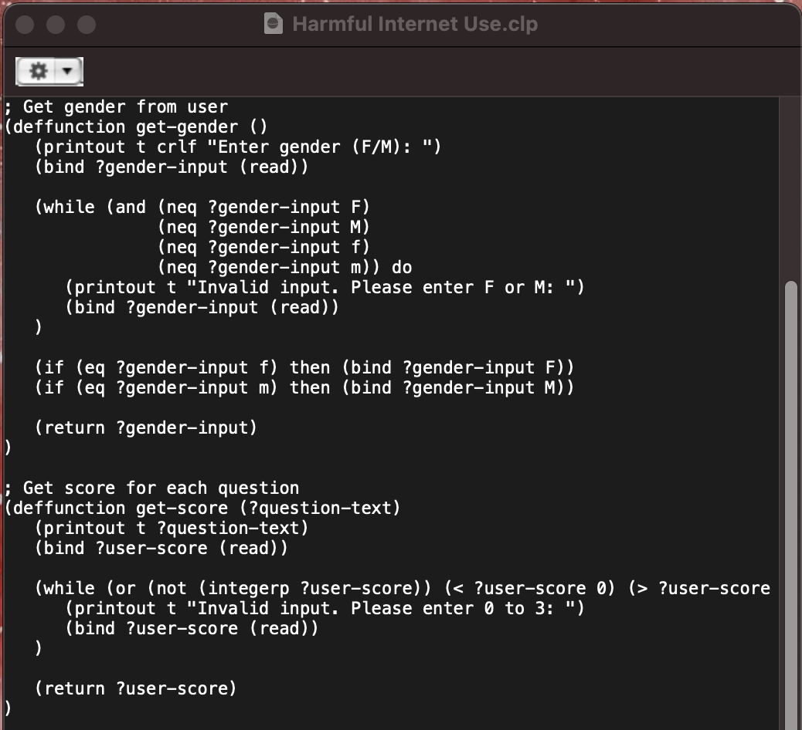
Function Example

Slide 17
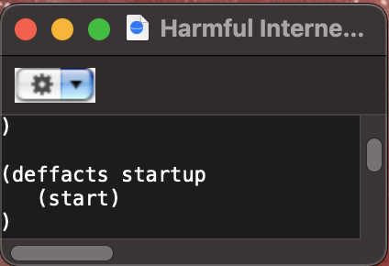
Fact Example

Slide 18
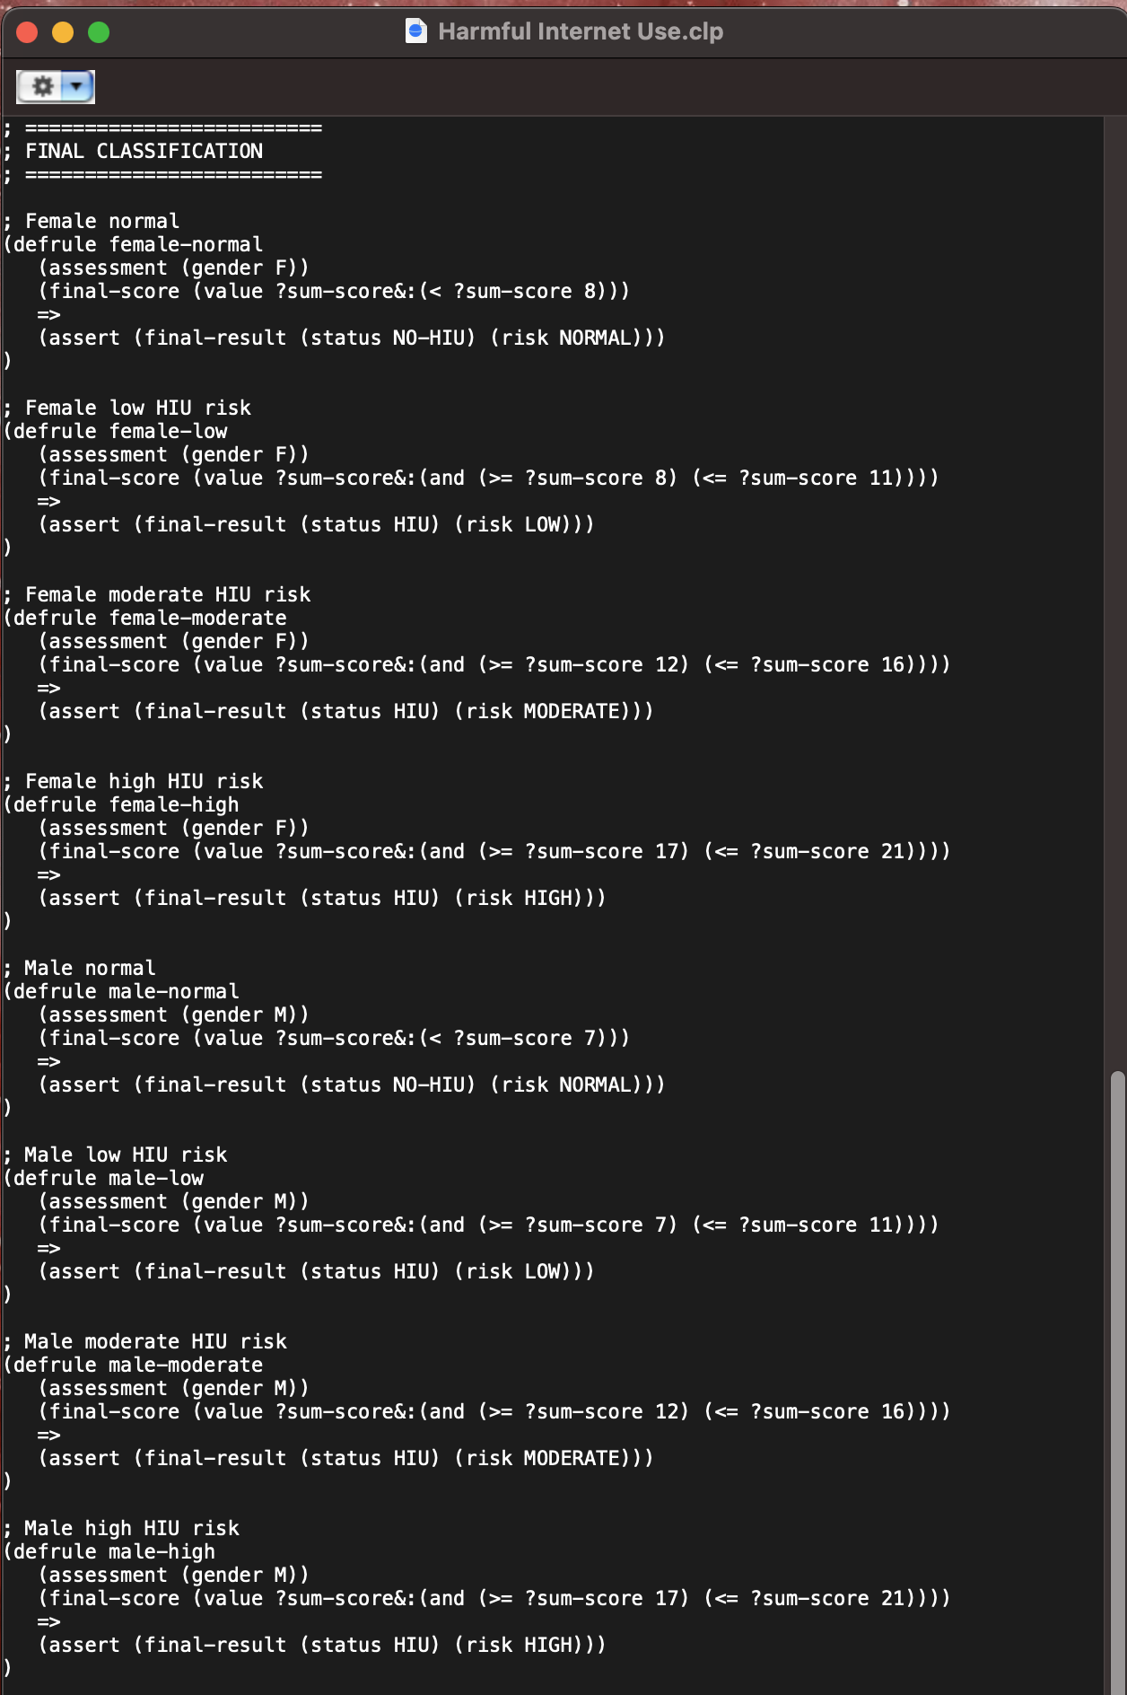
Rule Example of Our code

Slide 19
Reference
https://www1.se.cuhk.edu.hk/~seem5750/CLIPS%201.pdf
https://www.slideshare.net/slideshow/introduction-to-clips-expert-system-presentation/578788
https://blog.ldtalentwork.com/2020/04/26/how-to-build-an-expert-system-with-clips/

